Slide 1
Hibernate Intro
Tabel data Informatika

Slide 2
Agenda
Overview
Fitur Hibernate
Library
Memulai Hibernate
Summarize
Latihan

Slide 3
Overview
Hibernate:
Hibernate was started in 2001 by Gavin King with colleagues from Cirrus Technologies as an alternative to using EJB2-style entity beans. The original goal was to offer better persistence capabilities than those offered by EJB2; by simplifying the complexities and supplementing certain missing features.
Opensource (LGPL)
Mature
Popular (13 000 downloads/month)

Slide 4
Overview
Modern” ORM Solutions
Transparent Persistence (POJO/JavaBeans)
Persistent/transient instances
Automatic Dirty Checking
Transitive Persistence
Lazy Fetching
Outer Join Fetching
Runtime SQL Generation
Three Basic Inheritance Mapping Strategies

Slide 5
Why ?
Natural programming model
Minimize LOC
Code can be run and/or tested outside the “container”
Classes may be reused in “nonpersistent” context
Minimize database access with smart fetching strategies
Opportunities for aggressive caching
Structural mapping more robust when object/data model changes

Slide 6
Entity Beans?
Transparent Persistence
Persistent/transient instances
Automatic Dirty Checking
Transitive Persistence
Lazy Fetching
Outer Join Fetching
Runtime SQL Generation
Three Basic Inheritance Mapping Strategies

Slide 7
Just Do It!
Create Persistent Class
Create Hibernate Config
Create Hibernate Util
Run!

Slide 8
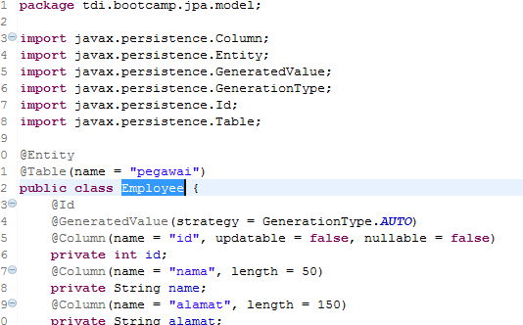
Create Persistent Class

Slide 9
@Entity, @Table, @Id …..
@Entity : plain old java object (POJO)
The Class represent table in relational database.
@Table : table properties in relational database
@Id : unique identifier (primary key), Persistent Identity

Slide 10
Requirements for Entities
Boleh Serializable, tapi tidak wajib
Wajib jika passed by value (pada remote call)
Entities boleh extend entity dan non-entity classes
Non-entity classes boleh extend entity classes
Persistent instance variables dideclared private, protected, or package-private

Slide 11
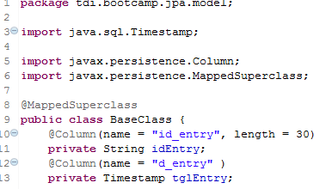
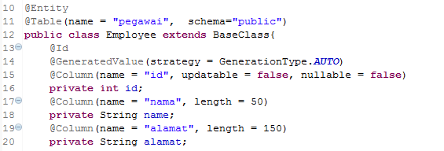
Extends Entities
Entity dapat extends kelas lain menggunakan @MappedSuperclass

Slide 12
Identifier Generation
Identifiers bisa di generated oleh database dengan @GeneratedValue
4 generation strategies:
AUTO, IDENTITY, SEQUENCE, TABLE
Generators bisa sudah ada atau generated
AUTO = provider will choose a strategy

Slide 13

Mulai !

Slide 14
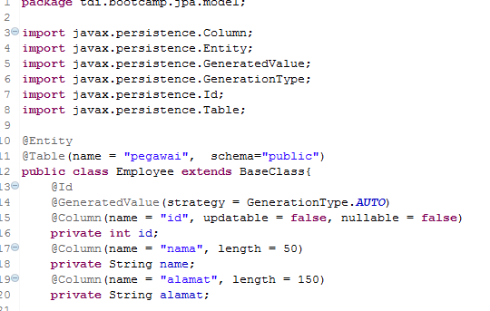
Buat Entity

Slide 15
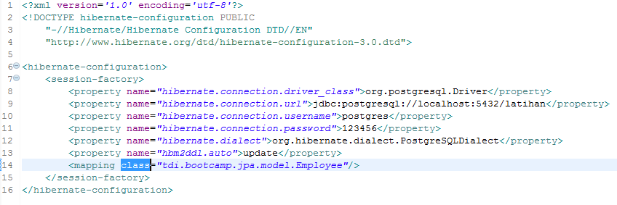
Hibernate Config

Slide 16
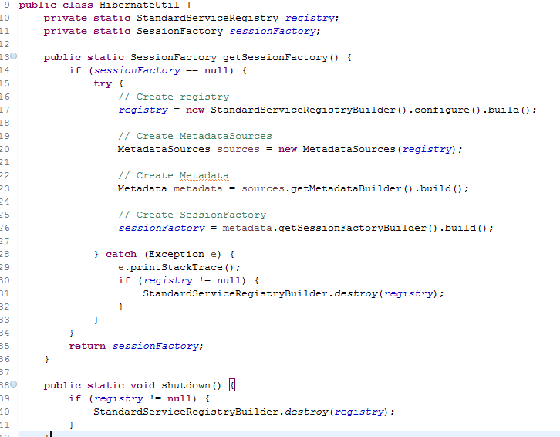
Hibernate Util

Slide 17
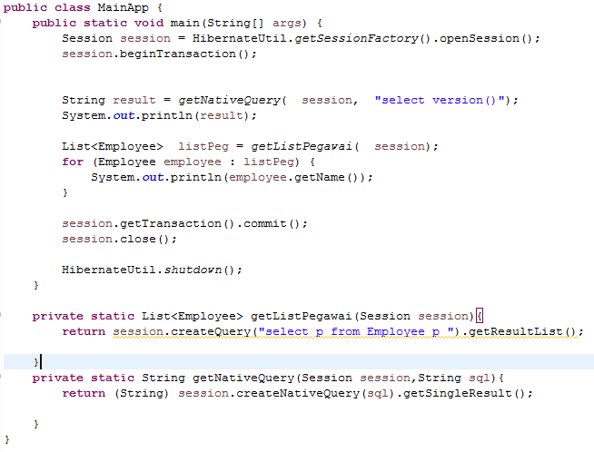
Main Class

Slide 18

Run

Slide 19

Exercise

Slide 20
Exercise 30 Menit
Buat kelas Departement dengan field utama sebagai berikut
id (long)
nama (String)
idEntry (String)
tglEntry (Timestamp)

Slide 21
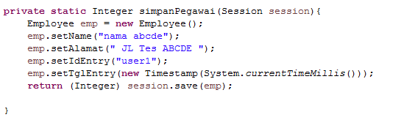
Insert

Slide 22
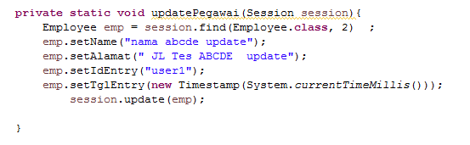
Update

Slide 23
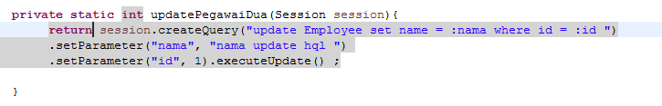
Alternatif Update

Slide 24
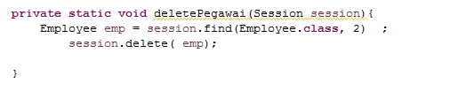
Delete

Slide 25
Exercise

Slide 26
Buat Insert, update dan delete pada kelas Departement

